Slide 1
OSPF WITH 3 ROUTER
Step 1: First, open the cisco packet tracer desktop and select the devices…
Add 2pc or laptop (pc1, pc0)
Add 2 switch(switch 0, switch 1)
Add 3 router (router0,router1,router2)
Step 2: Configure the PCs (hosts) with IPv4 address and Subnet Mask according to the IP addressing suchas
Pc0-192.168.1.10/24
Pc1-192.168.2.10/24
Switch0-192.168.1.0/24
Switch 1-192.168.1.0/24
Router0- 192.168.1.1/24
Router3-192.168.2.1/14

Slide 2
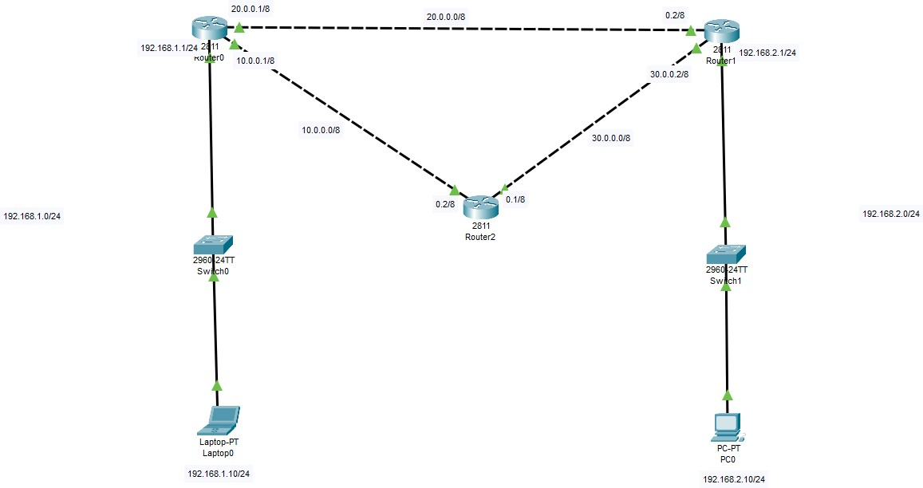
Configuring Router R0 (all interfaces):
Router>enable Router#conf t
Enter configuration commands, one per line. End with CNTL/Z. Router(config)#int fa0/0
Router(config-if)#ip add 192.168.1.1 255.255.255.0 Router(config-if)#no shut
Router(config-if)#
%LINK-5-CHANGED: Interface FastEthernet0/0, changed state to up
%LINEPROTO-5-UPDOWN: Line protocol on Interface FastEthernet0/0, changed state to up
Router(config-if)# Router(config-if)#exit Router(config)#int fa0/1
Router(config-if)#ip add 10.0.0.1 255.0.0.0 Router(config-if)#no shut
Router(config-if)#exit Router(config)#int fa1/0
Router(config-if)#ip add 20.0.0.1 255.0.0.0 Router(config-if)#no shut
Router(config-if)#
%LINK-5-CHANGED: Interface FastEthernet1/0, changed state to up
Router(config-if)#

Slide 3
Configuring Router R1 (all interfaces):
Router>en Router#conf t
Enter configuration commands, one per line. End with CNTL/Z. Router(config)#int fa1/0
Router(config-if)#ip add 20.0.0.2 255.0.0.0 Router(config-if)#no shut
Router(config-if)#
%LINK-5-CHANGED: Interface FastEthernet1/0, changed state to up
%LINEPROTO-5-UPDOWN: Line protocol on Interface FastEthernet1/0, changed state to up
Router(config-if)#exit Router(config)#int fa0/1
Router(config-if)#ip add 30.0.0.2 255.0.0.0 Router(config-if)#no shut
Router(config-if)#exit Router(config)#int fa0/0
Router(config-if)#ip add 192.168.2.1 255.255.255.0 Router(config-if)#no shut
Router(config-if)#
Configuring Router R2 (all interfaces):
Router>en Router#conf t
Enter configuration commands, one per line. End with CNTL/Z. Router(config)#int fa0/0
Router(config-if)#ip add 10.0.0.2 255.0.0.0 Router(config-if)#no shut
Router(config-if)#exit
Router(config)#int fa0/1
Router(config-if)#ip add 30.0.0.1 255.0.0.0 Router(config-if)#no shut
Router(config-if)#

Slide 4
Configuring OSPF on Router R0:
Router>en Router#conf t
Enter configuration commands, one per line. End with CNTL/Z. Router(config)#
Router(config)#router ospf 1
Router(config-router)#network 192.168.1.0 0.0.0.255 area 0
Router(config-router)#network 10.0.0.0 0.255.255.255 area 0
Router(config-router)#network 20.0.0.0 0.255.255.255 area 0 Router(config-router)#exit
Router(config)#^Z Router#
%SYS-5-CONFIG_I: Configured from console by console
Router#wr
Building configuration... [OK]
Router#
Configuring OSPF on Router R1:
Router>en Router#conf t
Enter configuration commands, one per line. End with CNTL/Z. Router(config)#router ospf 1
Router(config-router)#network 20.0.0.0 0.255.255.255 area 0
Router(config-router)#netowrk 30.0
00:31:03: %OSPF-5-ADJCHG: Process 1, Nbr 192.168.1.1 on FastEthernet1/0 from LOADING to FULL, Loading Done
^
% Invalid input detected at '^' marker.
Router(config-router)#network 30.0.0.0 0.255.255.255 area 0
Router(config-router)#network 192.168.2.0 0.0.0.255 area 0 Router(config-router)#exit
Router(config)#^Z Router#
%SYS-5-CONFIG_I: Configured from console by console
Router#wr
Building configuration... [OK]
Router#

Slide 5
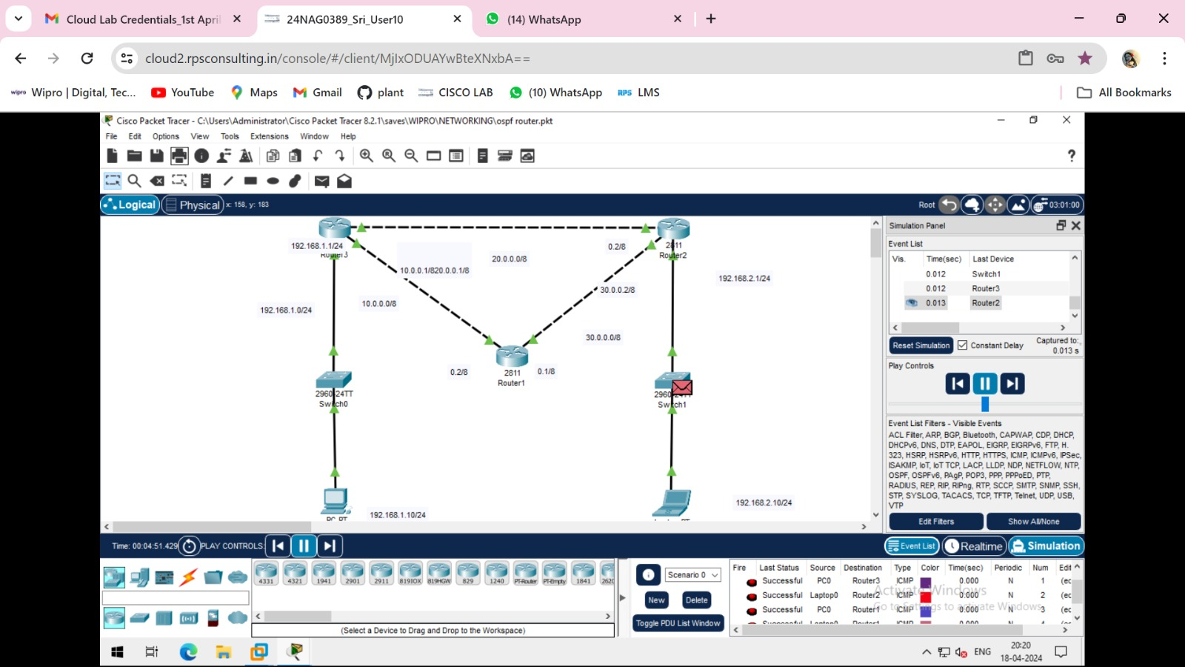
Configuring OSPF on Router R2:
Router>en Router#conf t
Enter configuration commands, one per line. End with CNTL/Z. Router(config)#router ospf 1
Router(config-router)#network 10.0.0.0 0.255.255.255 area 0
Router(config-router)#network 30.0.0.0
00:35:58: %OSPF-5-ADJCHG: Process 1, Nbr 192.168.1.1 on FastEthernet0/0 from LOADING to FULL, Loading Done
% Incomplete command.
Router(config-router)#network 30.0.0.0 0.255.255.255 area 0 Router(config-router)#exit
Router(config)#^Z Router#
%SYS-5-CONFIG_I: Configured from console by console
Router#wr
Building configuration... [OK]
After ping to the pc0 to pc1 and router the stimulation is below

